Slide 1
PRODUCT RECOMMENDATION FOR E-COMMERCE
USING MACHINE LEARNING
PRESENTED BY:
ASTHALOCHAN MOHANTA,
SWAGAT MOHANTY & BISWANATH SAHOO

Slide 2

Agenda
Introduction
Recommender System
Collaborating Filtering
Real time recommendations
Data Collections
Algorithm
Case Study
Benefits and Impact
Conclusion

Slide 3

INTRODUCTION
Now most of the people are using e-commerce websites to shop many items.
Turning to big challenge for a retail store to provide the right products accordingly to customer preferences.
E-commerce websites use different types of recommendation systems to provide a positive shopping experience

Slide 4
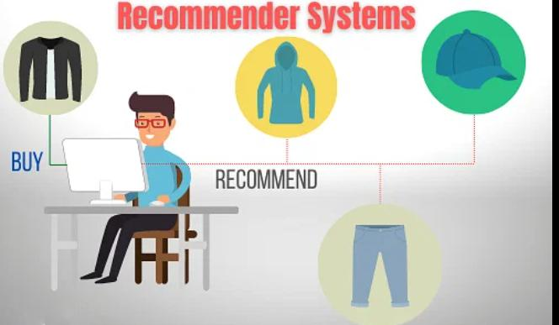
RECOMMENDER SYSTEMS
A recommendation system is an algorithmic approach that suggests personalized items to users based on their preferences and past behaviors, aiming to enhance user experience and facilitate decision-making.

Slide 5
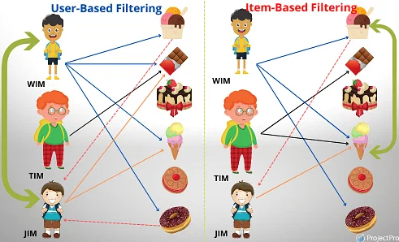
TYPES OF RECOMMENDATION SYSTEMS
Collaborative Filtering
Content-Based Filtering

Slide 6
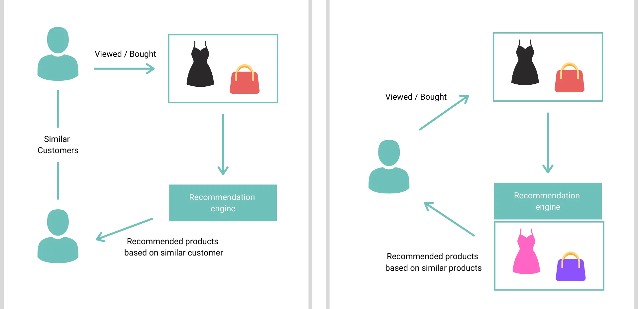
COLLABORATIVE FILTERING
Collaborating filtering uses algorithm to filter data from user reviews to make personalized recommendations for users with similar preference.

Slide 7
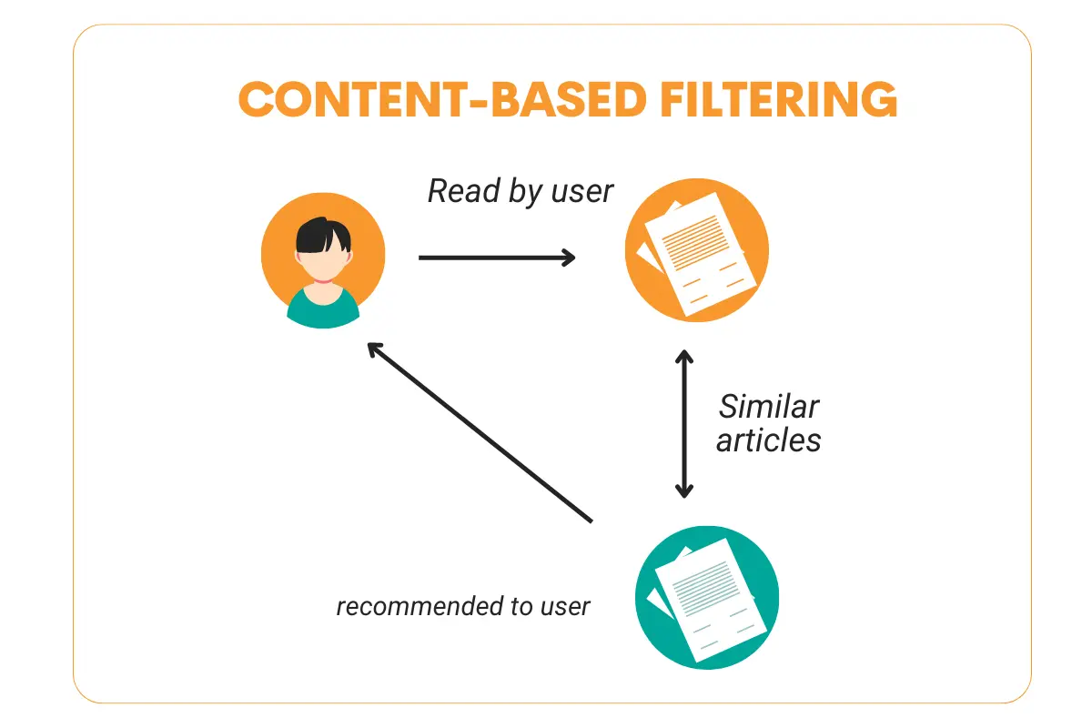
CONTENT-BASED FILTERING
Content-based filtering uses item features to recommend other items similar to what the user likes, based on their previous actions or explicit feedback.

Slide 8
REAL-TIME RECOMMENDATIONS
Real-time recommendation systems:-It is a recommendation system typically shows items to users based on their profiles and preferences and by observing their actions such as buying,liking or viewing items.
Streaming data and online learning:-Streaming data is data that is generated continuously by thousands of data sources, which typically send in the data records simultaneously, and in small sizes (order of Kilobytes).
Challenges and considerations:-Challengers and considerations refer to the obstacles and factors that need to be taken into account when addressing a particular issue or pursuing a specific goal . They can arise in various contexts,such as business, technology,personal relationships, or societal issues.some common challenges and considerations include.

Slide 9
DATA COLLECTION AND PREPROCESSING
Importance of high-quality data:-Data quality is essential for one main reason You give customers the best experience when you make decisions using accurate data.
Collect Amazon Dataset of Beauty Product Rating from Amazon (2023070)
Drop the missing and null data:-Missing or null means there is no value present at all. For the survey data we are looking at now,it means the person taking the survey provided no answer.
Data set Source : Kaggle (Amazon Beauty Product )

Slide 10
ALGORITHMS FOR RECOMMENDATION
Matrix Factorization:-In this technique used to decompose a matrix into a product of two or more smaller matrices. it’s used in recommendation system to extract latent factors and improve prediction accuracy.
A = U Σ V^{T}
PCA (Truncated SVD):-It retaining only a subset of the largest singular value
and their corresponding singular vectors.
Source: Research Paper (California State University )

Slide 11
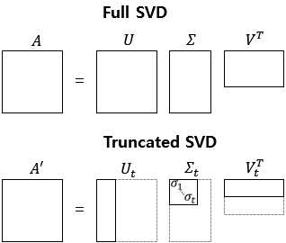
Matrix Factorization(Truncated SVD)
This transformer performs linear dimensionality reduction by means of truncated singular value decomposition (SVD).
It is Similar to PCA, this estimator does not center the data before computing the singular value decomposition. This means it can work with sparse matrices efficiently.
Source : Wikipedia

Slide 12
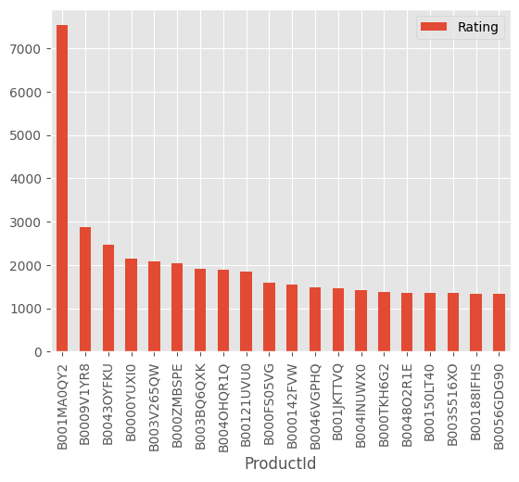
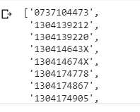
CASE STUDIES
here is the top 10 product which is recommended by system if a customer buy product(id- 753865058X)

Slide 13
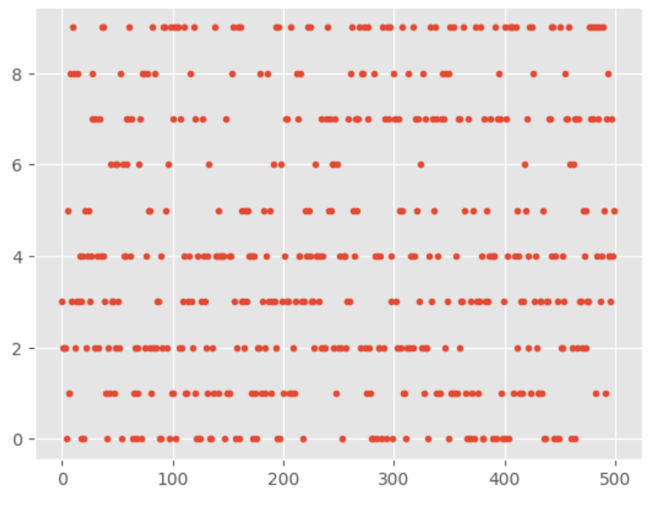
Visualizing product clusters in subset of data

Slide 14
BENEFITS AND IMPACT
Enhanced user experience and customer satisfaction
Increased conversion rates and revenue
Personalization and customer retention

Slide 15
CONCLUSION
We aim to get the best shopping experience, saving time and effort
In Future prospects include advancements in deep learning, context-aware recommendations, multi-modal recommendations, explainable recommendations, reinforcement learning, integration with voice and natural language processing, and a focus on ethical and fair recommendations.

Slide 16

REFERENCES:-
1. Sarwar, B., Karypis, G., Konstan, J., & Riedl, J. (2001). Item-based collaborative filtering recommendation algorithms. In Proceedings of the 10th international conference on World
Wide Web (WWW '01) (pp. 285-295). ACM.
2. Koren, Y., Bell, R., & Volinsky, C. (2009). Matrix factorization techniques for recommender systems. Computer, 42(8), 30-37.
3. Ricci, F., Rokach, L., & Shapira, B. (2015). Introduction to recommender systems handbook. In Recommender Systems Handbook (pp. 1-35). Springer.
4. Herlocker, J. L., Konstan, J. A., Borchers, A., & Riedl, J. (1999). An algorithmic framework for performing collaborative filtering. In Proceedings of the 22nd annual international ACM SIGIR conference on Research and development in information retrieval (pp. 230-237). ACM.
5. Lops, P., de Gemmis, M., & Semeraro, G. (2011). Content-based recommender systems: State of the art and trends. In Recommender Systems Handbook (pp. 73-105). Springer.
6. Koren, Y. (2008). Factorization meets the neighborhood: a multifaceted collaborative filtering model. In Proceedings of the 14th ACM SIGKDD international conference on Knowledge discovery and data mining (pp. 426-434). ACM.

Slide 17

THANK YOU

